Slide 1


Slide 2
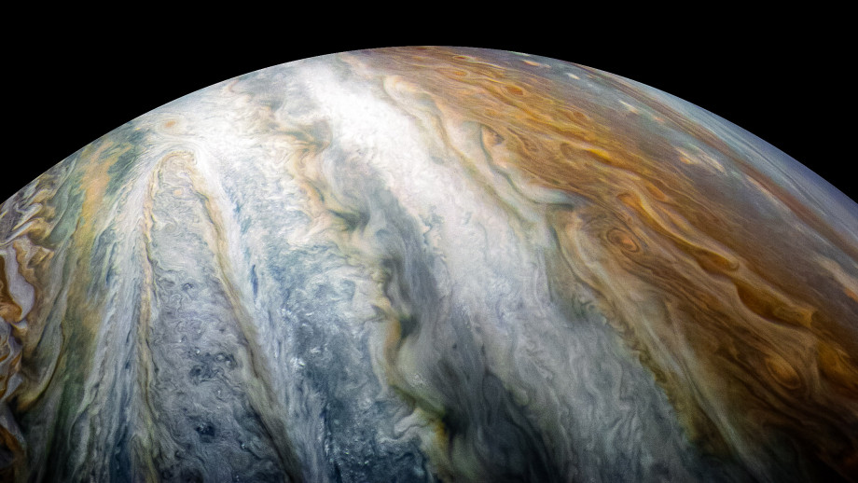
Notebooks in Azure Data Studio for the DBA

Slide 3
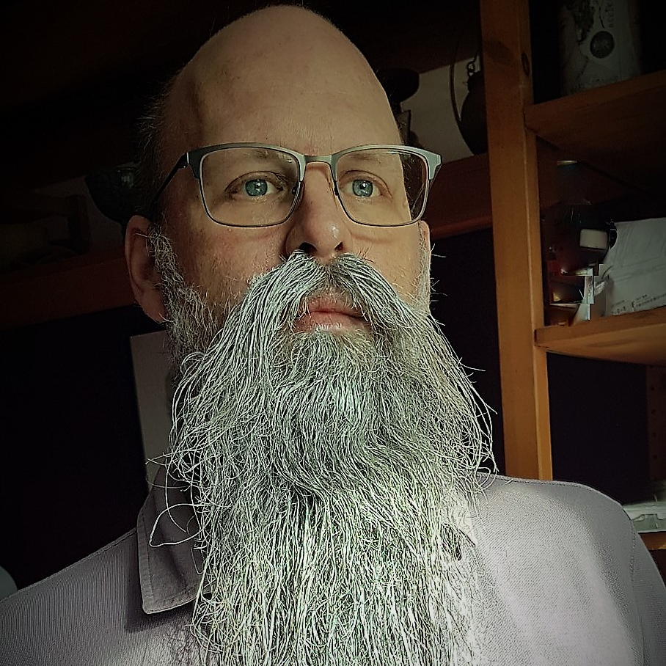



About me
Rob Sewell
Consultant
MVP and Beard Twizzler
@SqlDbaWithBeard
beard.media/book

Slide 4
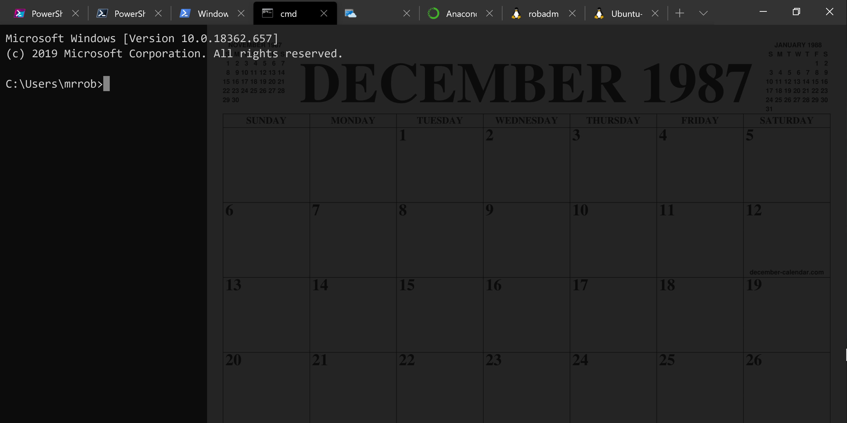
Running Queries
@SQLDBAWithBeard SqlDbaWithABeard.com Rob Sewell beard.media/book

Slide 5
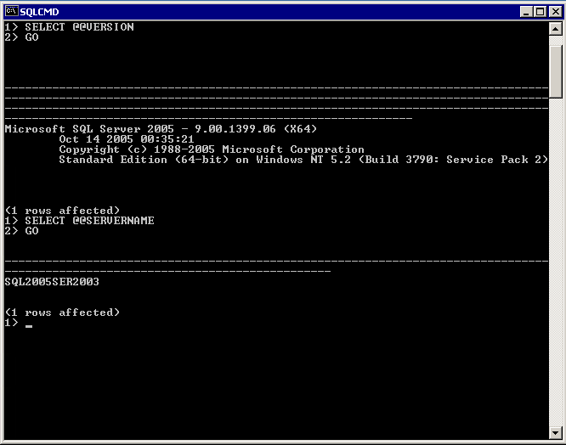
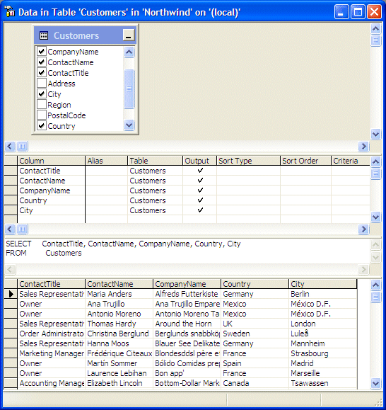
@SQLDBAWithBeard SqlDbaWithABeard.com Rob Sewell beard.media/book

Slide 6
Two and a Half Decades

Slide 7
Uh, Houston, we've had a problem
https://en.wikipedia.org/wiki/Houston,_we_have_a_problem
@SQLDBAWithBeard SqlDbaWithABeard.com Rob Sewell beard.media/book

Slide 8
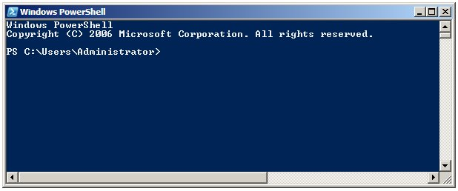
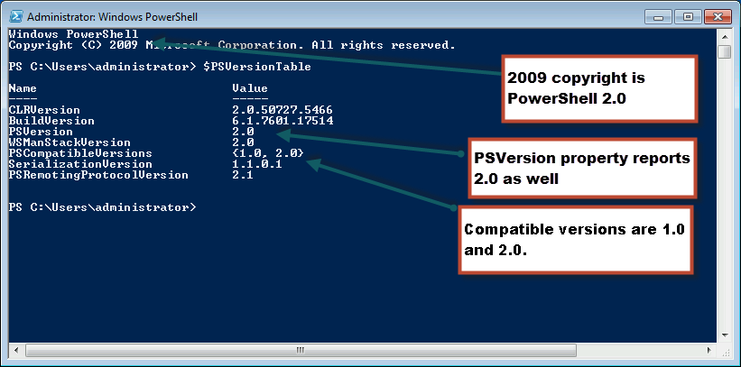
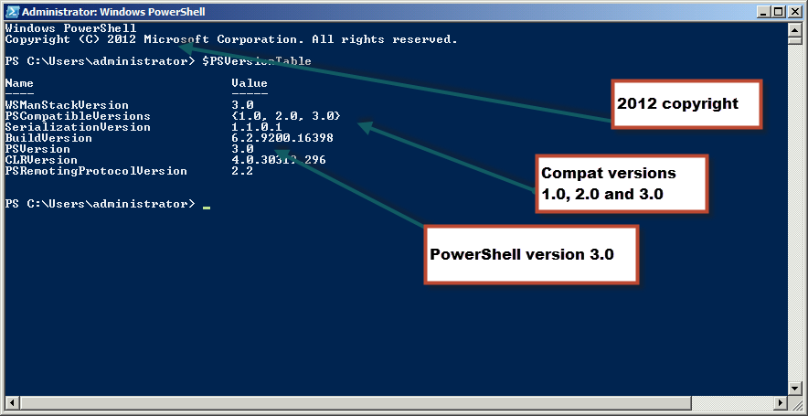
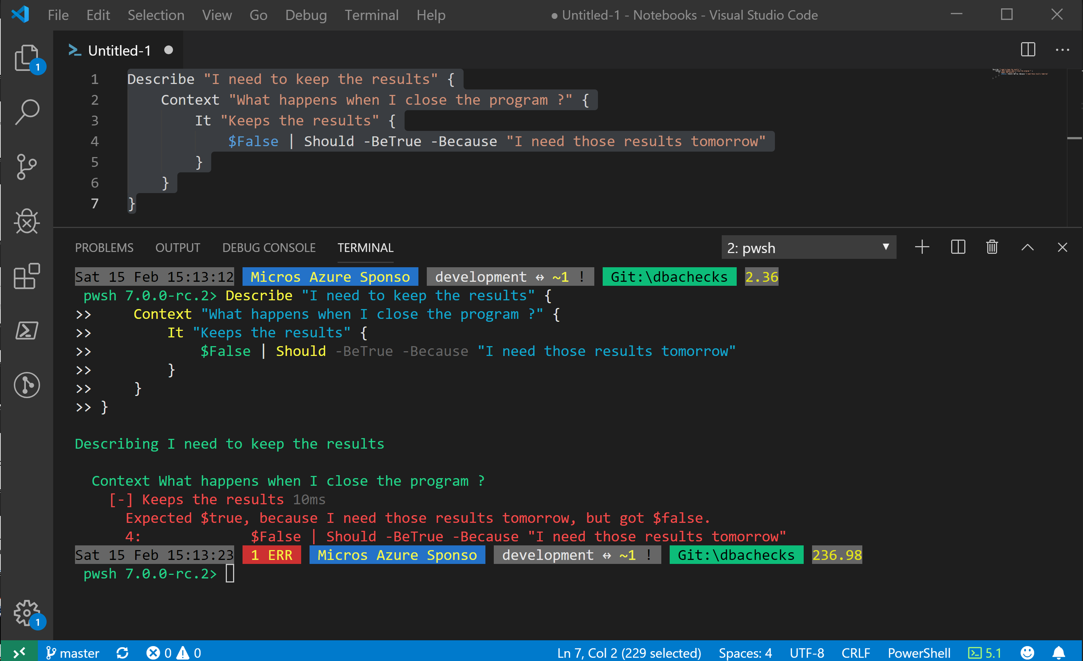
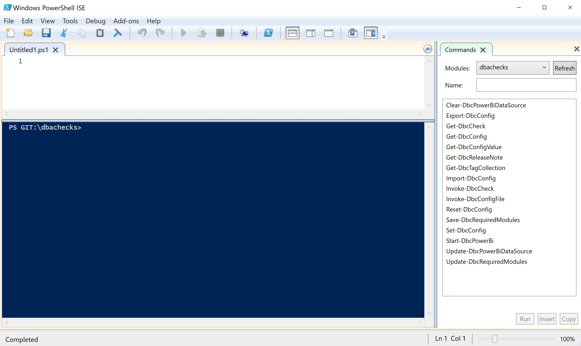
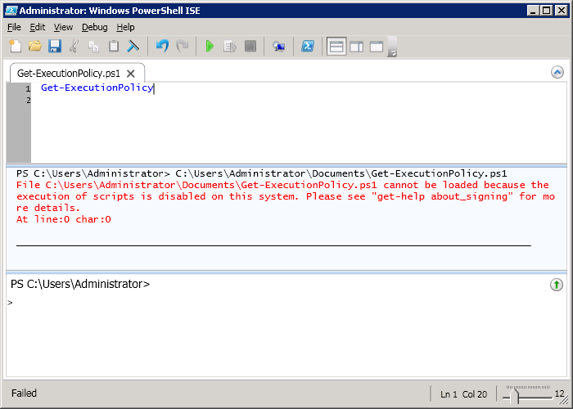
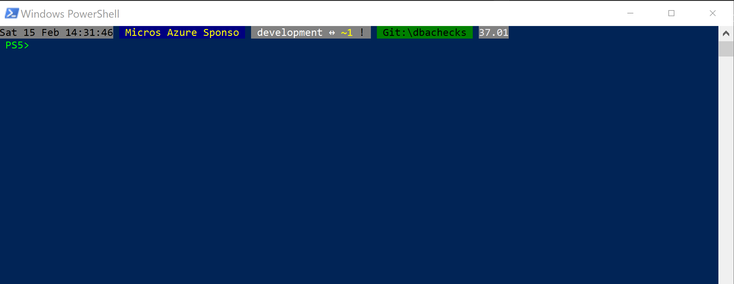
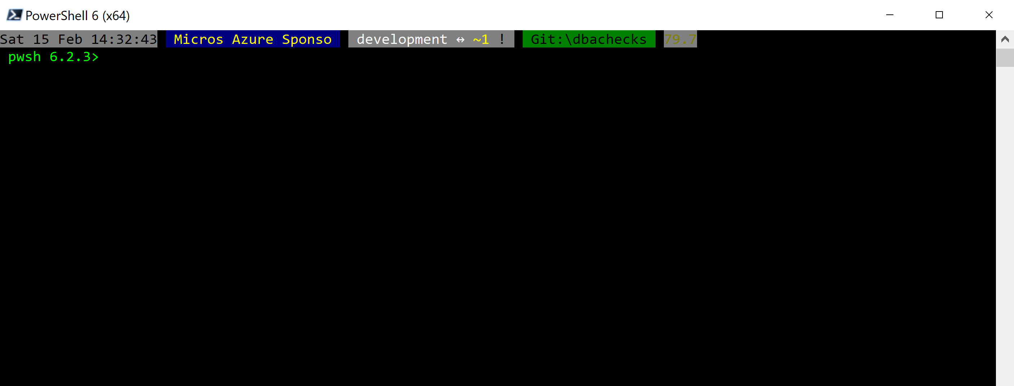
Without some effort………..

Slide 9
Without some effort………..

Slide 10
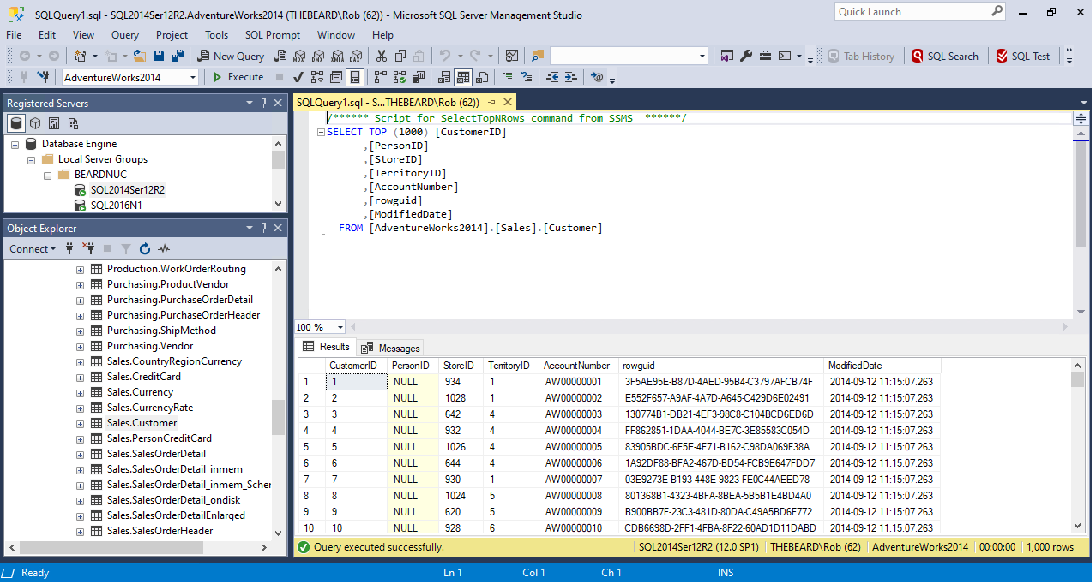

Slide 11
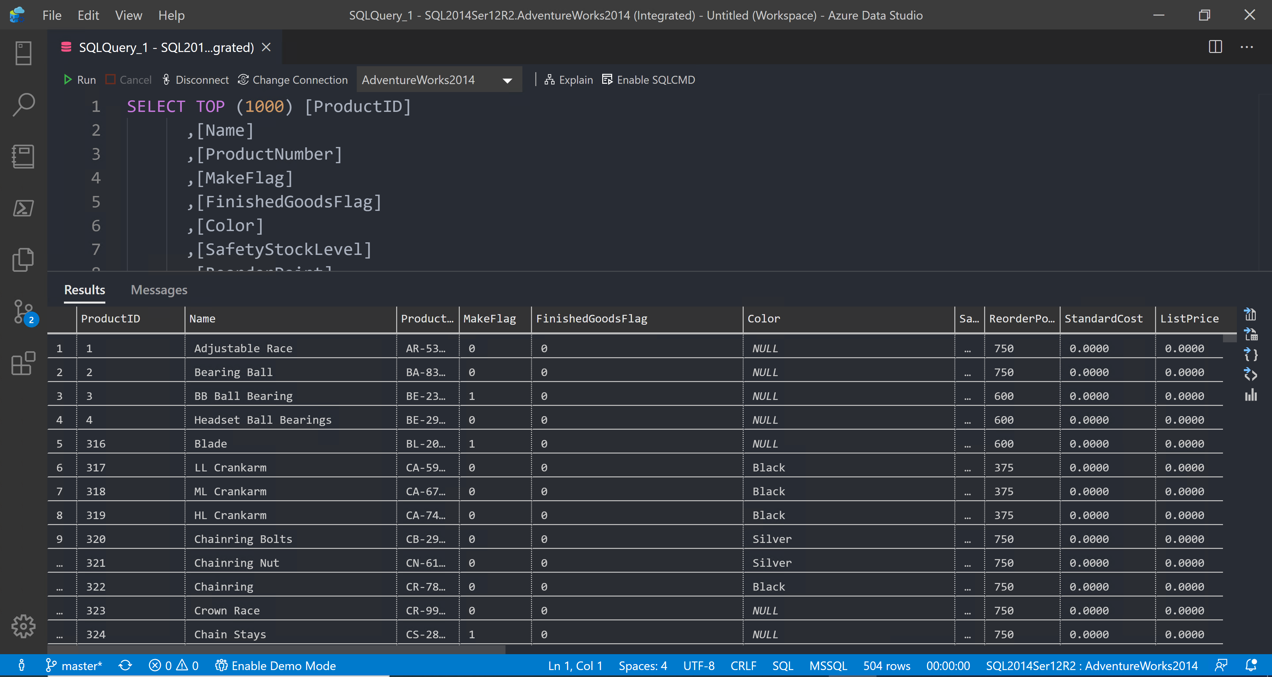

Slide 12
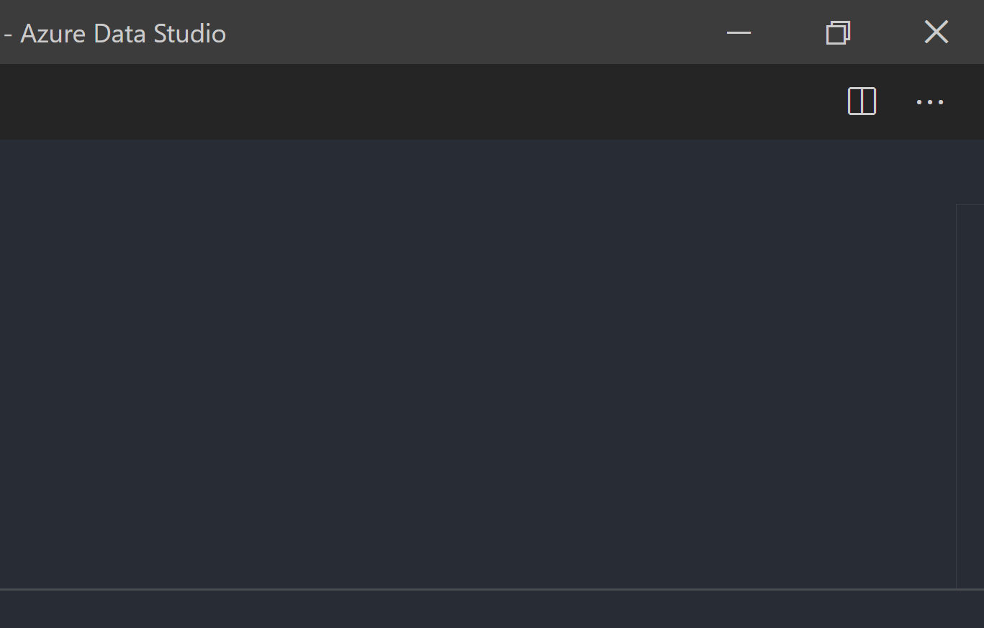
@SQLDBAWithBeard SqlDbaWithABeard.com Rob Sewell beard.media/book

Slide 13
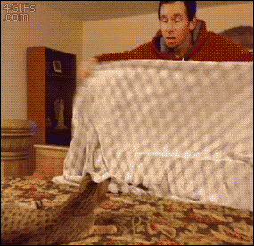
@SQLDBAWithBeard SqlDbaWithABeard.com Rob Sewell beard.media/book

Slide 14

@SQLDBAWithBeard SqlDbaWithABeard.com Rob Sewell beard.media/book

Slide 15
ALL
GONE
@SQLDBAWithBeard SqlDbaWithABeard.com Rob Sewell beard.media/book

Slide 16
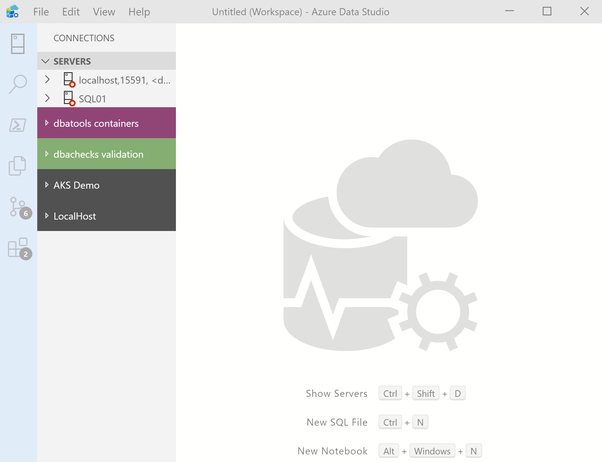
What’s Azure Data Studio ?
Cross Platform desktop environment for Data Professionals
@SQLDBAWithBeard SqlDbaWithABeard.com Rob Sewell beard.media/book

Slide 17

So it’s only for Azure?
@SQLDBAWithBeard SqlDbaWithABeard.com Rob Sewell beard.media/book

Slide 18
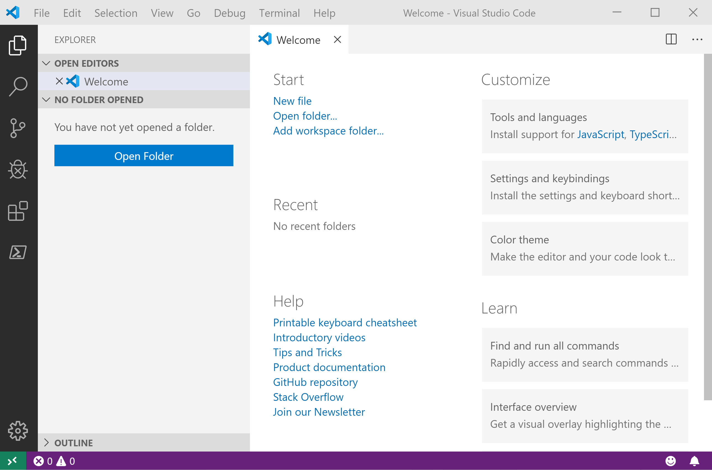
It Looks Like Visual Studio Code ?
@SQLDBAWithBeard SqlDbaWithABeard.com Rob Sewell beard.media/book

Slide 19
It Looks Like Visual Studio Code ?
@SQLDBAWithBeard SqlDbaWithABeard.com Rob Sewell beard.media/book

Slide 20
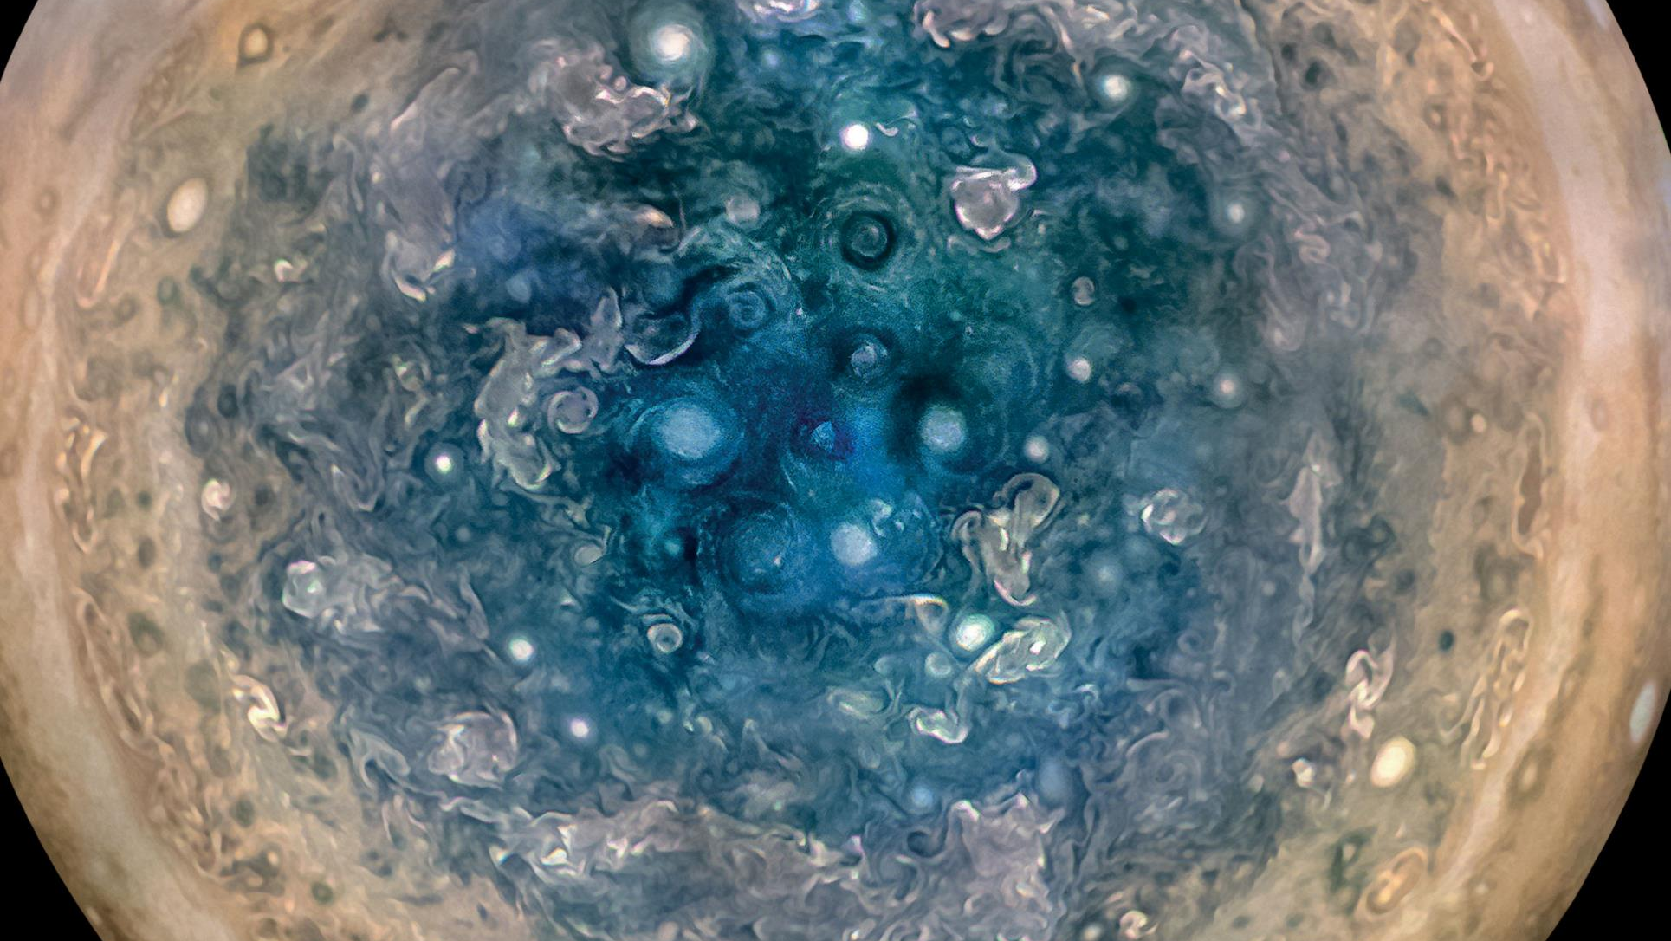

Slide 21
Jupyter

Slide 22
Jupyter
First, the name comes from the planet Jupiter. We wanted to pick a name that evoked the traditions and ideas of science.
https://github.com/jupyter/design/wiki/Jupyter-Logo

Slide 23
Jupyter
Second, the core programming languages supported by Jupyter are
Julia, Python and R.
While the name Jupyter is not a direct acronym for these languages, it nods its head in those directions.
In particular, the "y" in the middle of Jupyter was chosen to honor our Python heritage.
https://github.com/jupyter/design/wiki/Jupyter-Logo

Slide 24
Jupyter
Third, Galileo was the first person to discover the moons of Jupiter. His publication on the moons of Jupiter is an early example of research that includes the underlying data in the publication.
This is one of the core ideas and requirements for scientific reproducibility.
Reproducibility is one of the main focuses of our project.
https://github.com/jupyter/design/wiki/Jupyter-Logo

Slide 25
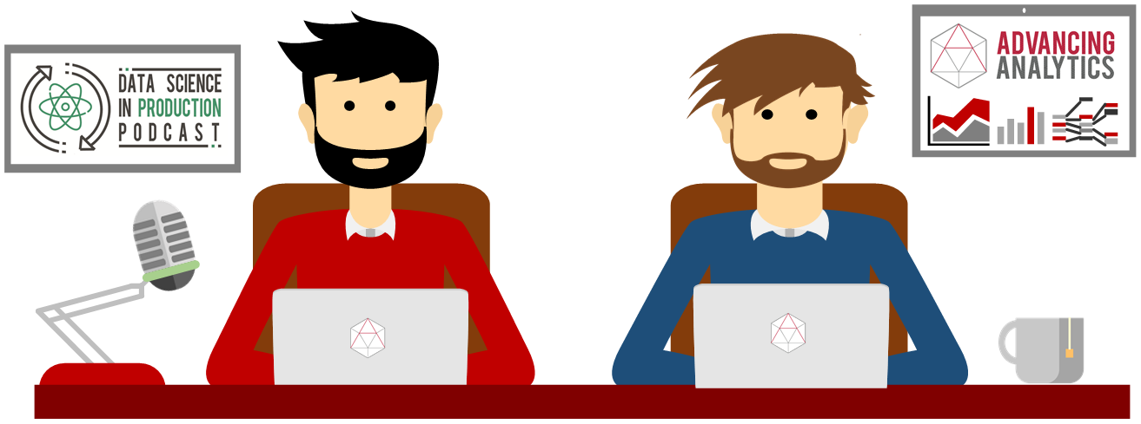
What is a Jupyter Notebook?
Originally for Data Scientists

Slide 26
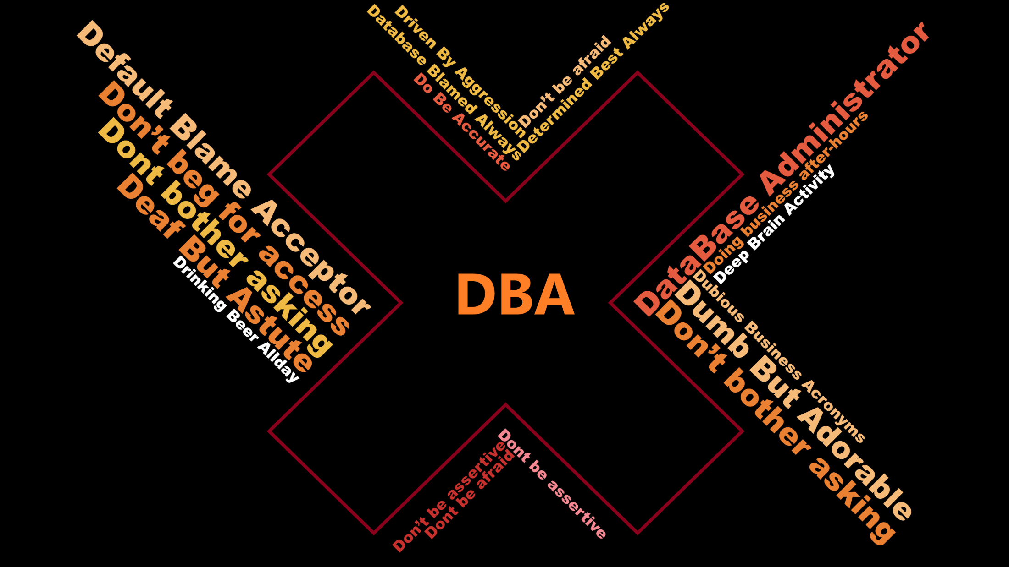

Slide 27
What is a Jupyter Notebook?
Document that can contain text, code, images and query results
@SQLDBAWithBeard SqlDbaWithABeard.com Rob Sewell beard.media/book

Slide 28

Hey Beardy – Enough Talk!
Time For A DEMO

Slide 29

Up next
How administrate the hell out of your database
John Smith
Data Wrangler

Slide 30


Virtual booth
Get your virtual swag bag
Live chat to Redgaters and book 1-2-1 meetings
Discuss sessions with other attendees
Enter our competition to win an awesome prize
Sign up for Thursday’s pub quiz

